Slide 1
Homeostatic mechanism of major functional system Dr Shahneela Siraj Associate Professor DIKIOHS,DUHS.

Slide 2
Learning objectives
At the end of lecture ,students should be able to:
Define homeostasis
Describe the components of a feedback system
Contrast the operation of negative & positive feedback systems
Explain the principles of homeostasis as a central theme of Physiology
Describe feedforward mechanism with example
List the factors that contribute to homeostatic imbalance.

Slide 3
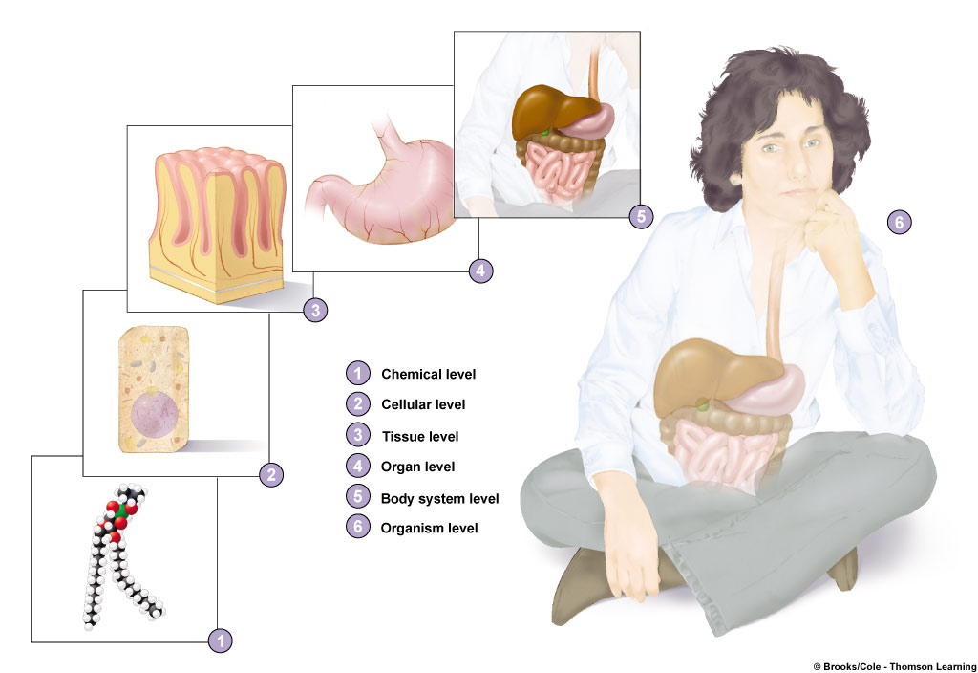
Functional Organization of the Body
Levels of organization
Chemical
Molecules composed
of atoms
Cellular
Cells are basic unit
of life
Tissue
Organ
Body system
Organism

Slide 4
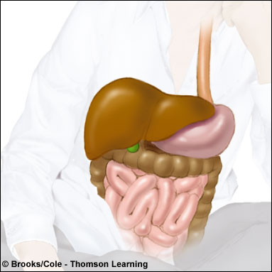
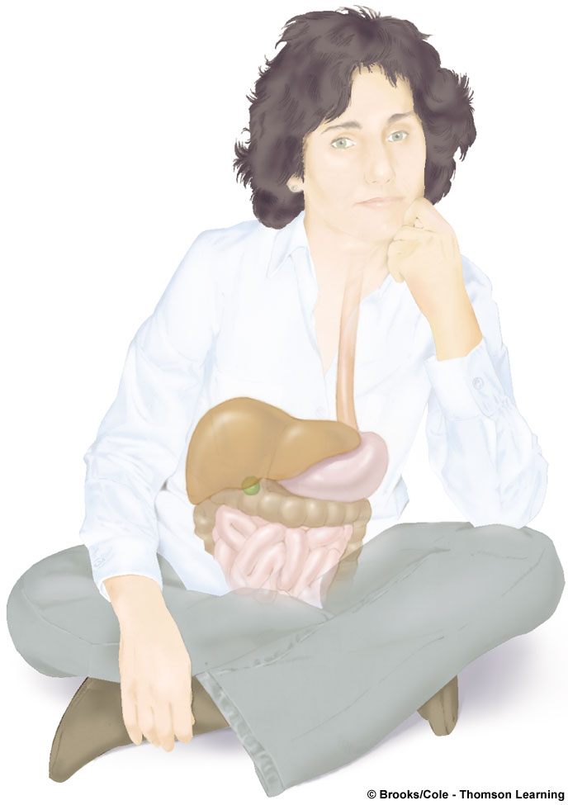
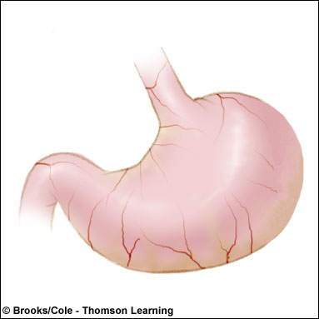
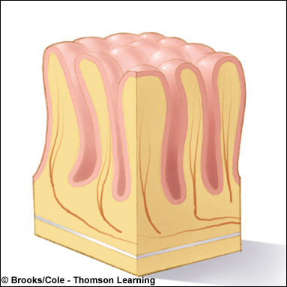
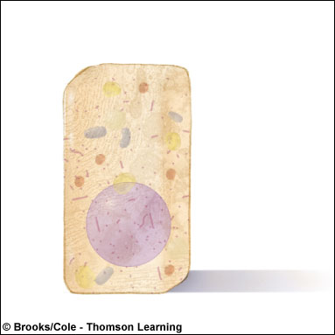
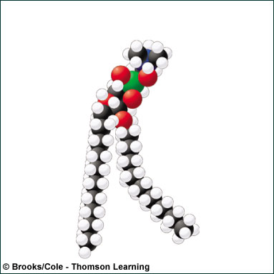
5
6
4
3
1
Chemical level
2
2
Cellular level
3
Tissue level
4
Organ level
5
Body system level
1
6
Organism level

Slide 5
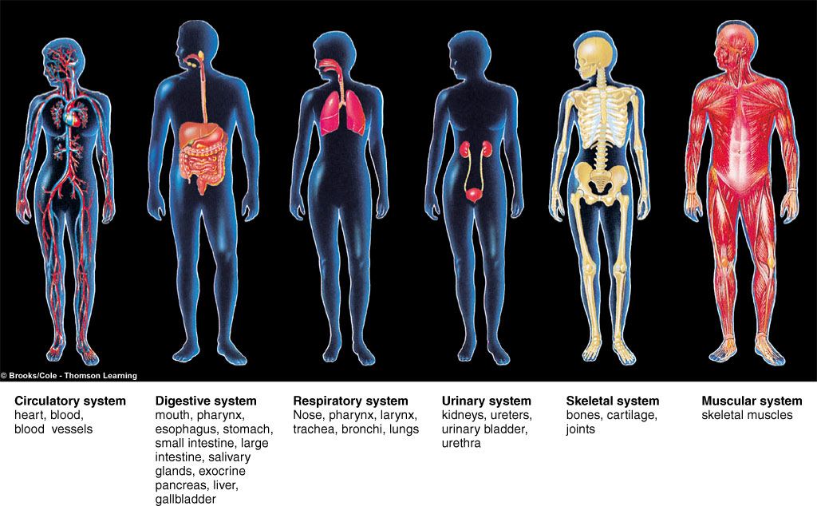
Body Systems

Slide 6
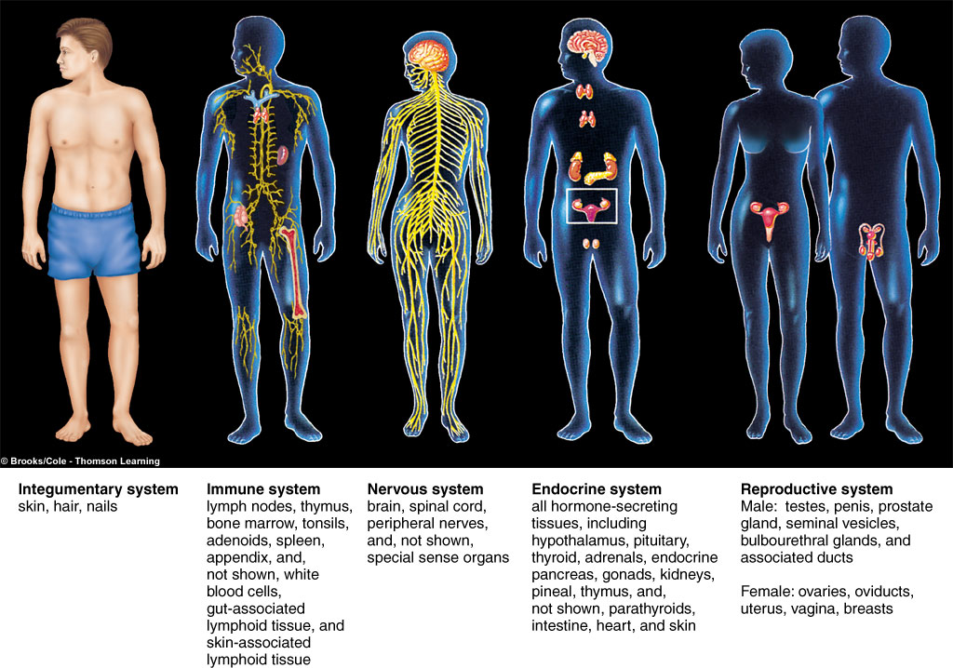
Body Systems

Slide 7
Physiology
“A branch of biology dealing with the functions and activities of living organisms and their parts”
“Physiology is the study of the normal function of cell, tissue, organs, systems and organisms, including all physical and chemical processes.”
Physiology (from Ancient Greek: physio = nature; logos = study): study of how the body works to maintain life
cell 🡪 tissue 🡪 organ 🡪 organ system 🡪 organism
Human physiology is the scientific study of normal body function.
Notes:
A sub-discipline of biology, its focus is in how organisms, organ systems, organs, cells, and bio-molecules carry out the chemical or physical functions that exist in a living system.
Human physiology seeks to understand the mechanisms that work to keep the human body alive and functioning, through scientific enquiry into the nature of mechanical, physical, and biochemical functions of humans, their organs, and the cells of which they are composed

Slide 8
Physiology Study of Functions of Living Things
Two approaches to explain body functions
Emphasis on purpose of body process (Why)
Explanations are in terms of meeting a bodily need
Emphasis on Mechanism (How)
Explanations are in terms of cause and effect sequences
Body is viewed as a machine.

Slide 9
Homeostasis
The maintenance of a constant environment in the body is called Homeostasis

Slide 10
Homeostasis
Maintain – keep up.
Constant – the same.
Internal – inside the body.
Environment – surroundings of the body.

Slide 11
Homeostasis
The term ‘Homeostasis’ is derived from two Greek words;
Homeo which means ‘unchanging’
Stasis which means ‘standing’

Slide 12
Homeostasis
Defined as maintenance of a relatively stable internal environment
So, a better definition of ‘Homeostasis’ is the maintenance of the internal environment within narrow limits

Slide 13
Homeostasis Homeostasis
Defined as maintenance of a relatively stable internal environment
Does not mean that composition, temperature, and other characteristics are absolutely unchanging
Homeostasis is essential for survival and function of all cells
Each cell contributes to maintenance of a relatively stable internal environment

Slide 14
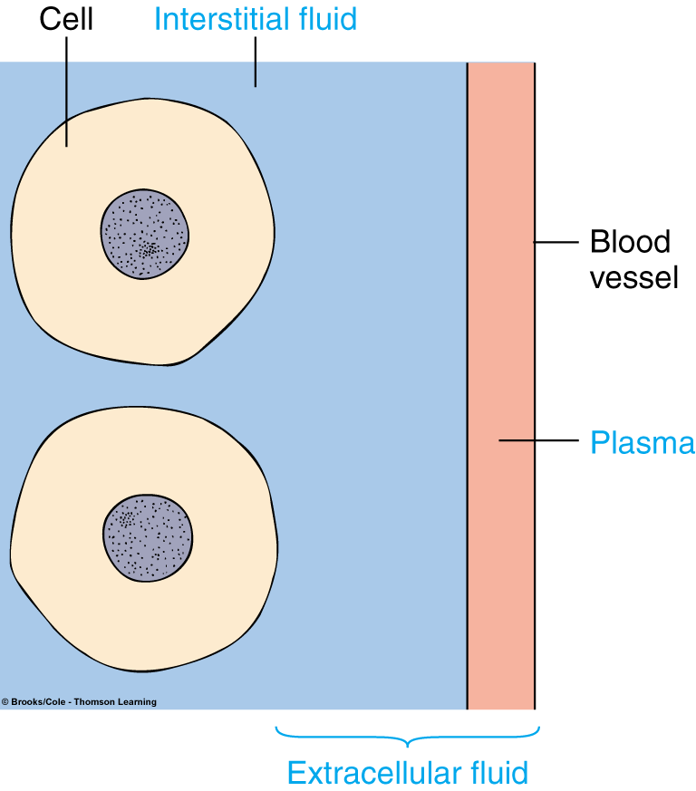
Homeostasis
Body cells are contained in watery internal environment through which life-sustaining exchanges are made
Extracellular fluid (ECF) - Fluid environment in which the cells live (fluid outside the cells)
Two components:
Plasma
Interstitial fluid
Intracellular fluid (ICF) - Fluid contained within all body cells

Slide 15
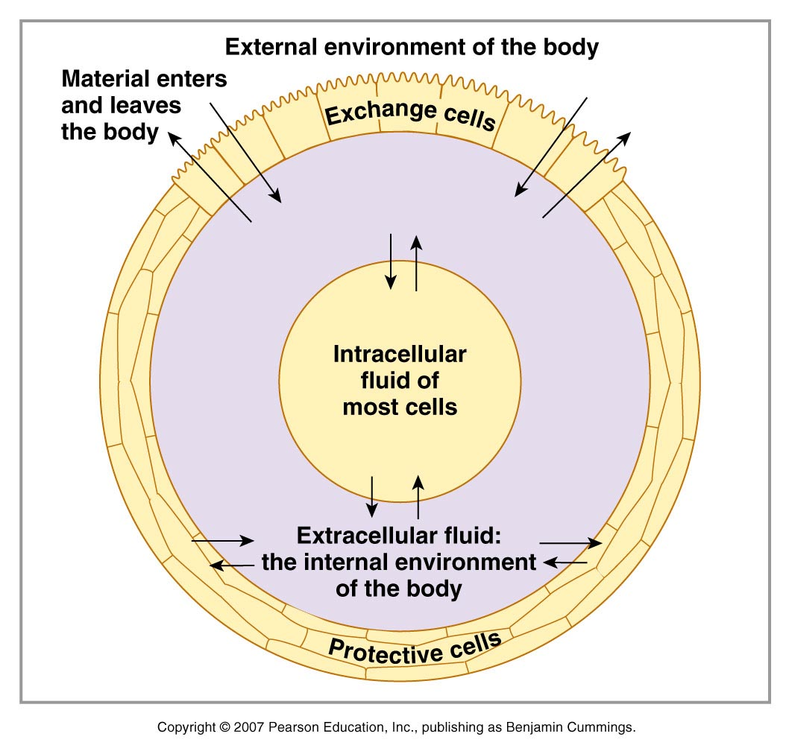
Homeostasis

Slide 16
Homeostasis
Homeostasis is continually being disrupted by
External stimuli:
heat, cold, lack of oxygen, pathogens, toxins
Internal stimuli:
Body temperature
Blood pressure
Concentration of water, glucose, salts, oxygen, etc.
Physical and psychological distresses

Slide 17
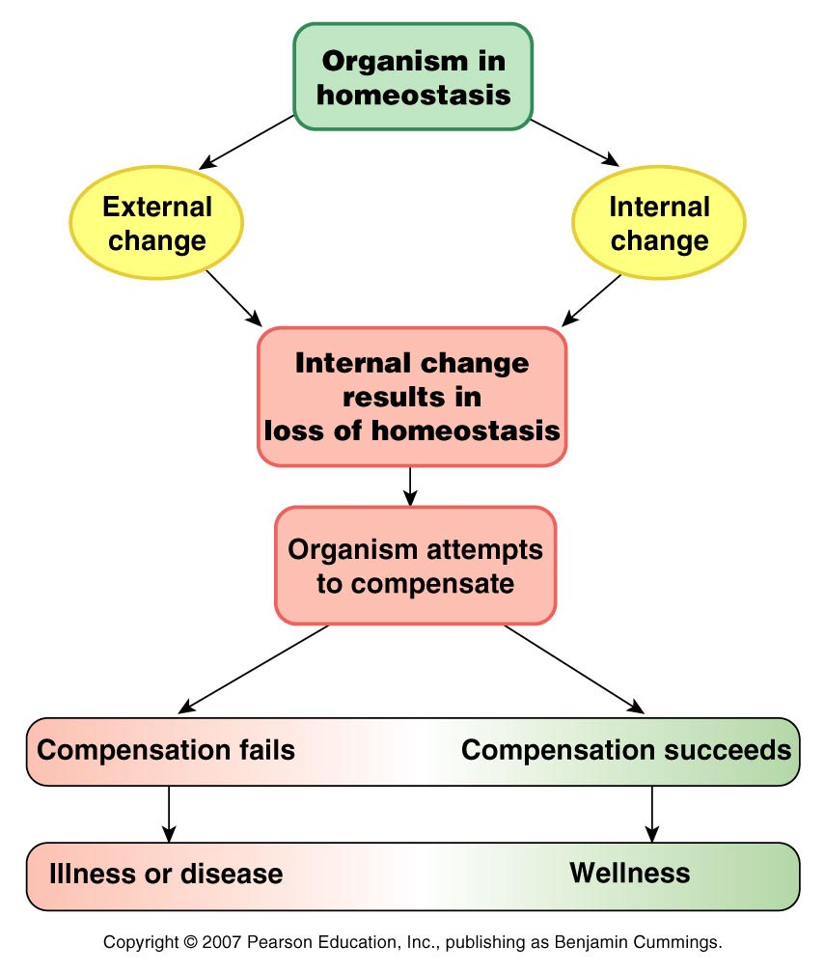
Homeostasis

Slide 18
Homeostasis
Homeostatic Control Systems
Detect deviations from normal (set point) in the internal environment that need to be held within narrow limits
Integrate this information with other relevant information
Make appropriate adjustments in order to restore factor to its desired value

Slide 19
Homeostasis
Homeostasis involves dynamic mechanisms that detect and respond to deviations in physiological variables from their “set point” values by initiating effector responses that restore the variables to the optimal physiological range.
Two systems that maintain homeostasis are: Nervous system & Endocrine system

Slide 20
Maintenance of Homeostasis
Nervous system
Controls and coordinates bodily activities that require rapid responses
Detects and initiates reactions to changes in external environment
Endocrine system
Secreting glands of endocrine regulate activities that require duration rather than speed
Controls concentration of nutrients and, by adjusting kidney function, controls internal environment’s volume and electrolyte composition

Slide 21
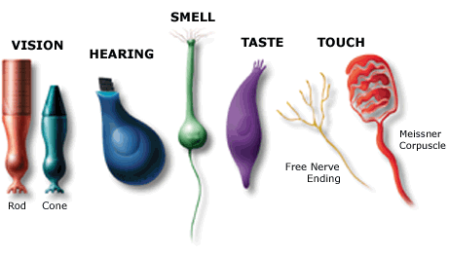
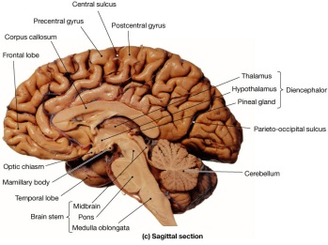
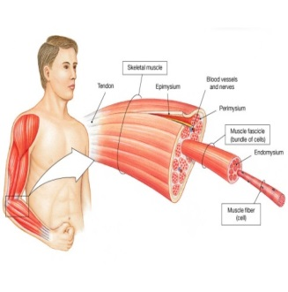
Homeostasis
Receptor - structures that monitor a controlled condition and detect changes
Control center - determines next action
Effector
Receives directions from the control center
Produces a response that restores the
controlled condition

Slide 22
Homeostasis
Feedforward - term used for responses made in anticipation of a change
Feedback - refers to responses made after change has been detected
Types of feedback systems
Negative
Positive

Slide 23
Homeostasis
Negative feedback loop
original stimulus reversed
most feedback systems in the body are negative
used for conditions that need frequent adjustment
Positive feedback loop
original stimulus intensified
seen during normal childbirth

Slide 24
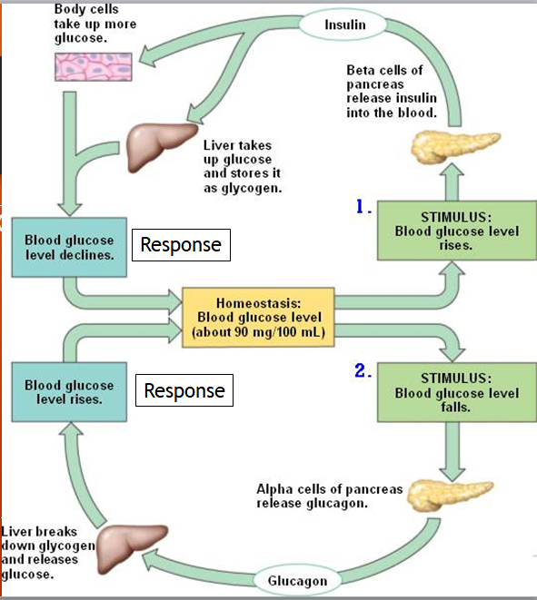
Negative Feed Back Mechanism
If the response reverses the original stimulus
Eg: GLUCOSE HOMEOSTASIS

Slide 25
CONTROLLING BLOOD GLUCOSE LEVELS
Homeostasis
This is regulated by 2 hormones from the pancreas called:
Insulin
Glucagon

Slide 26
Homeostasis
Glucose
Concentration
Glucose levels rise after a meal.
Insulin is produced and glucose levels fall to normal again.
Normal
Meal eaten
Time

Slide 27
Homeostasis
Glucose levels rise after a meal.
Glucose
Concentration
Diabetic
Insulin is not produced so glucose levels stay high
Time
Meal eaten

Slide 28
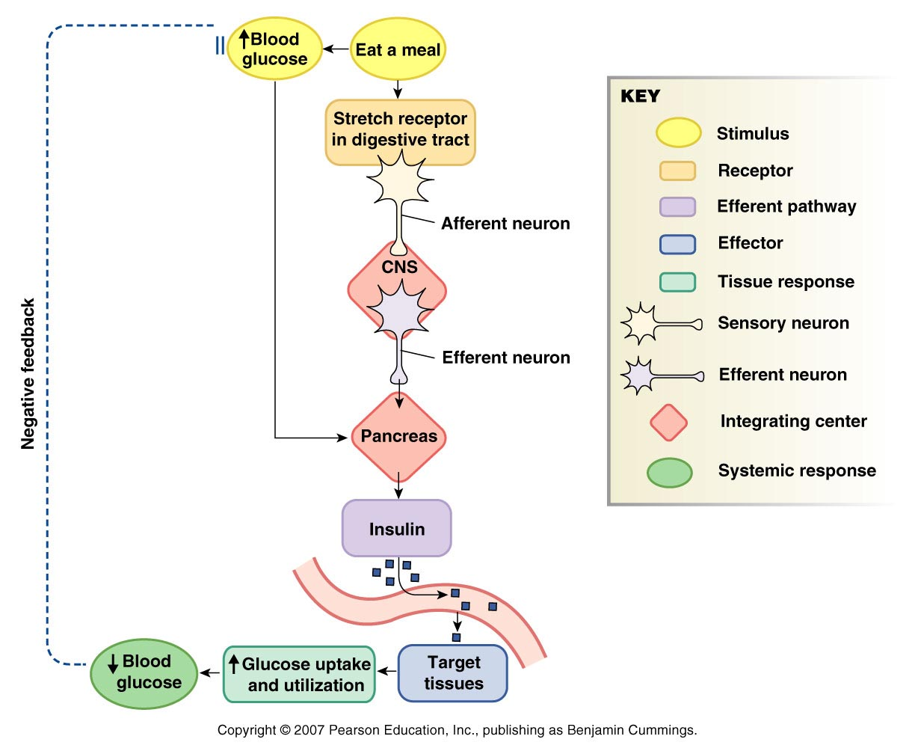
Homeostasis

Slide 29
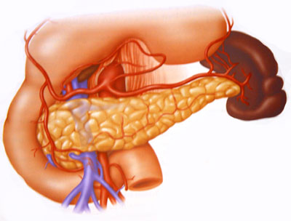
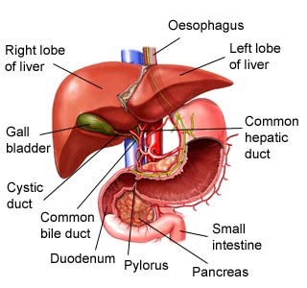
Glucose and Insulin
Glucose intake occurs during digestion of food that is needed for energy expenditure to perform routine physical activities.
The pancreas is the key organ that regulates the glucose levels in body by secreting two hormones, insulin and glucagon.
The liver also helps to store the excess glucose in form of glycogen to be utilized later.
Pancreas
Liver

Slide 30
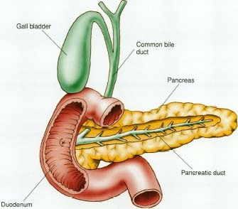
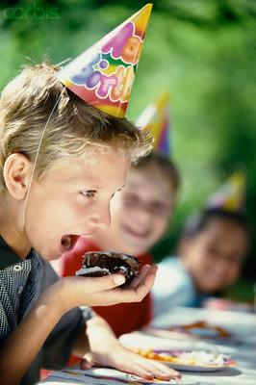
Glucose and Insulin Negative Feedback Loop
Boy eating cake
Increases Glucose Levels
(-)
CYCLE 1
Stimulates β cells of pancreas to secrete insulin
Lowers Blood Glucose levels
Insulin stimulates the cells to take up glucose from the blood.

Slide 31
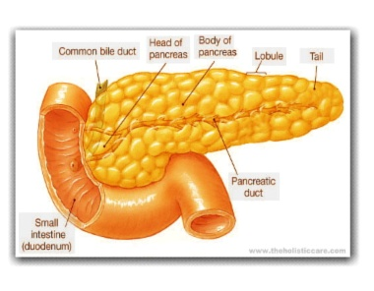
CYCLE 2
Low Blood Glucose Levels
(-)
Stimulated Alpha Cells in Pancreas
High blood glucose levels and Cycle 1 continues
Glucagon is released
Glucagon stimulates liver cells to release glucose into the blood

Slide 32
Glucose and Insulin Negative Feedback Loop
Two primary Hormones
The opposite actions of these two hormones, insulin and glucagon, helps to maintain normal blood sugar levels in the body hence maintain homeostasis of the body.
Insulin
Glucagon
Lowers Blood Glucose Levels
Raises Blood Glucose
Levels

Slide 33
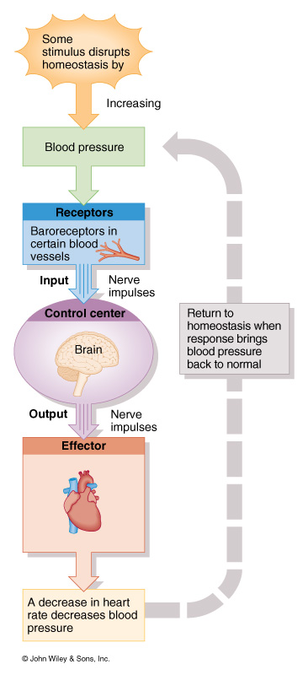
Control of Blood Pressure
Homeostasis
Baroreceptors in walls of blood vessels detect an increase in BP
Brain receives input and signals blood vessels and heart
Blood vessels dilate, HR decreases
BP decreases

Slide 34
Temperature regulation of Body
Animals that are capable of maintaining their body temperature within a given range are called homeotherms.
Temperature is regulated by negative feedback control.
Thermoreceptors located in hypothalamus detect temperature fluctuations in the body.

Slide 35
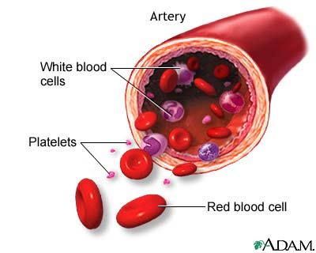
Temperature Regulation of the Body
Increased temperature causes vasodilatation (blood vessels near the surface of the skin dilate).
The large surface area allows heat to be lost from the blood and lowers the body temperature.
Sweating also helps lower the temperature.
Decreased temperature causes vasoconstriction (blood vessels constrict) and minimal heat loss occurs which helps maintain body temperature.
Hair on the body provides insulation and helps maintain body temperature.

Slide 36
Positive Feedback
A positive feedback loop occurs when the output of a system acts to enhance the changes to the input of the system.
One example of a biological positive feedback loop is the onset of contractions in childbirth.
When a contraction occurs, the hormone oxytocin is released into the body, which stimulates further contractions.
This results in contractions increasing in amplitude and frequency.
Notes:
http://en.wikipedia.org/wiki/Positive_feedback_loop#In_biology

Slide 37
Homeostasis
Positive Feedback
Stretch receptors in walls of uterus send signals to the brain
Brain induces release of hormone (oxytocin) into bloodstream
Uterine smooth muscle contracts more forcefully
More stretch, more hormone, more contraction etc.
Cycle ends with birth of the baby & decrease in stretch

Slide 38
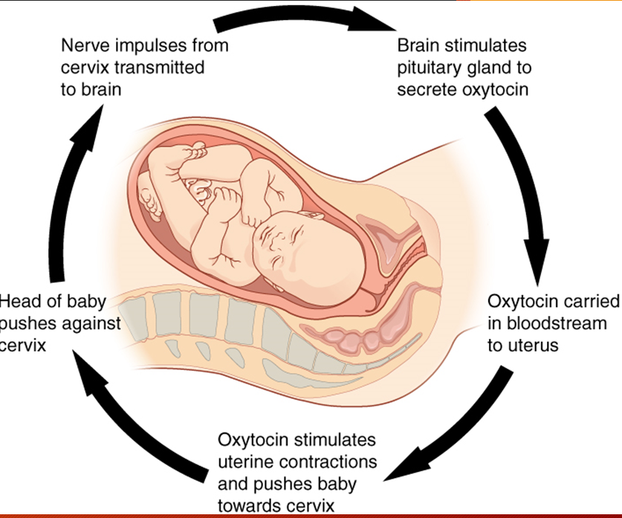

Slide 39
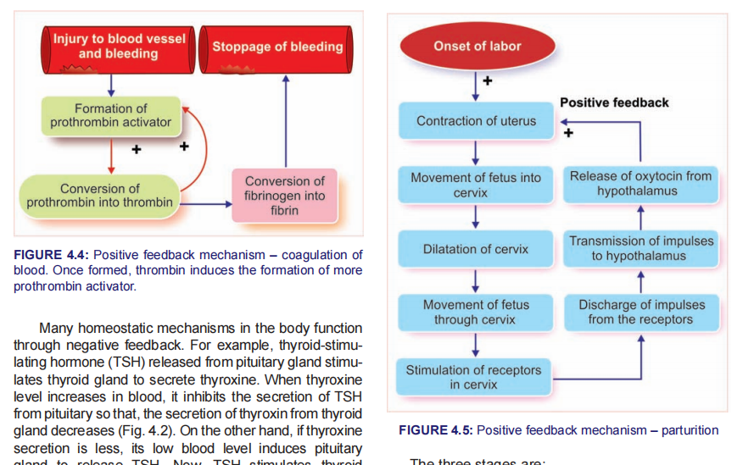

Slide 40
Positive Feedback
Another example is blood clotting.
The loop is initiated when injured tissue releases signal chemicals that activate platelets in the blood.
An activated platelet releases chemicals to activate more platelets, causing a rapid cascade and the formation of a blood clot.
Lactation involves positive feedback so that the more the baby suckles, the more milk is produced.
Notes:
http://en.wikipedia.org/wiki/Positive_feedback_loop#In_biology

Slide 41
Homeostasis
Factors homeostatically regulated include
Concentration of nutrient molecules e.g glucose
Concentration of water, salt, and other electrolytes
Concentration of waste products
Concentration of O₂ = 100mmHg and CO₂ = 40 mmHg
pH = 7.35
Blood volume 4-6 L and pressure 120/80
Temperature = 37º C

Slide 42
Positive Feedback
In most cases, once the purpose of the feedback loop is completed, counter-signals are released that suppress or break the loop.
Childbirth contractions stop when the baby is out of the mother's body.
Chemicals break down the blood clot.
Lactation stops when the baby no longer nurses.
Notes:
http://en.wikipedia.org/wiki/Positive_feedback_loop#In_biology

Slide 43
Homeostasis
Body cells work best if they have the correct
Temperature
Glucose concentration
Water levels

Slide 44
Homeostasis
Human body temperature 🡪 37ºC.
E.g. If your body is in a hot environment your body temperature is 37ºC
If your body is in a cold environment your body temperature is still 37ºC

Slide 45
Control of body temperature
Homeostasis
Sweating
When your body is hot, sweat glands are stimulated to release sweat.
The liquid sweat turns into a gas (it evaporates)
To do this, it needs heat.
It gets that heat from your skin.
As your skin loses heat, it cools down.

Slide 46
Homeostasis
Piloerection
It is sometimes called “goose bumps” or “chicken skin”!
This is when the hairs on your skin “stand up” .
The hairs trap a layer of air next to the skin which is
then warmed by the body heat
The air becomes an insulating layer.

Slide 47
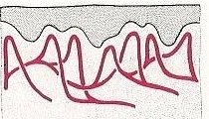
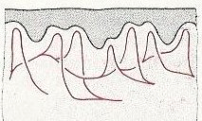
Homeostasis
Vasodilation
If the body temperature rises, the blood vessels in the skin dilate (become wider) and allow more blood to flow near the surface. The heat loss from the blood through the skin helps cool the circulating blood
Vasoconstriction
If the body temperature falls. The blood vessels in the skin constrict. Less warm blood flows near the surface so less heat is lost

Slide 48
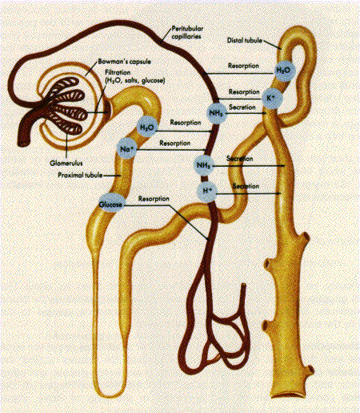
Kidney and Water Regulation
The nephron is the most important functional part of the kidney.
It filters nutrients like salts and amino acids in the Bowman’s capsule into ascending loop and filters the urine.

Slide 49
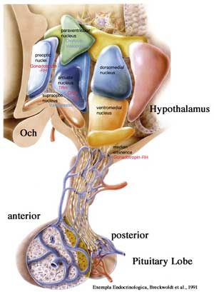
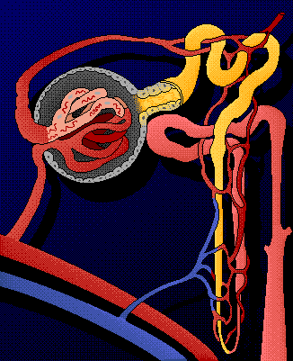
Kidney and Water Regulation
Anti-Diuretic Hormone, ADH (also called vasopressin), is secreted by the pituitary gland and acts on the nephron to conserve water and regulate the tonicity of body fluids.
Anti-
Diuretic
Hormone
ADH acts on Nephron to reabsorb water and decrease blood osmolality (saltiness)

Slide 50
ADH regulated water conservation in kidneys
Less water in the blood
Excess water in the blood
Stimulates osmoreceptors in hypothalamus to send signals to the pituitary gland
Stimulates osmoreceptors in hypothalamus to send signals to the pituitary gland
Pituitary glands secretes high levels of ADH
Pituitary glands secretes low levels of ADH
Less ADH makes the tubules less permeable and less water is reabsorbed back into the bloodstream (urine is dilute).
ADH makes the tubules more permeable and more water is reabsorbed back into the bloodstream (urine is concentrated).

Slide 51
ADH regulated water conservation in kidneys
Osmoregulators send negative feedback to the hypothalamus about the concentration of water in the bloodstream.
The hypothalamus then stimulates the pituitary glands to secrete high or low concentrations of anti-diuretic hormone.
ADH then makes the tubules more or less permeable and hence, maintains water and electrolyte homeostasis.

Slide 52
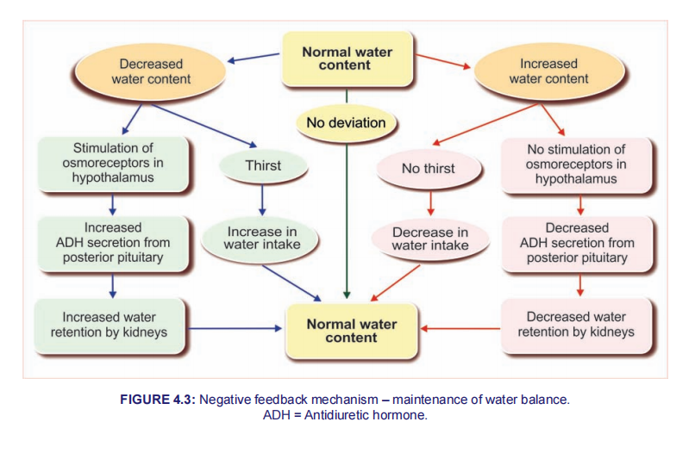

Slide 53
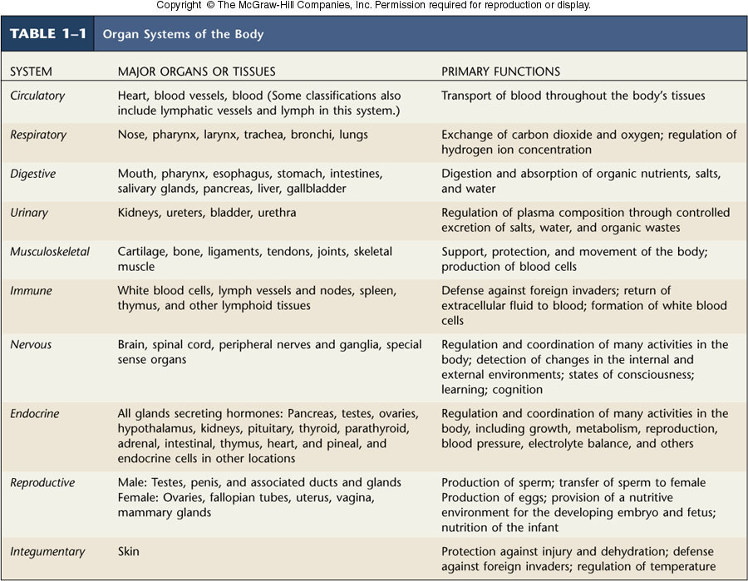

Slide 54
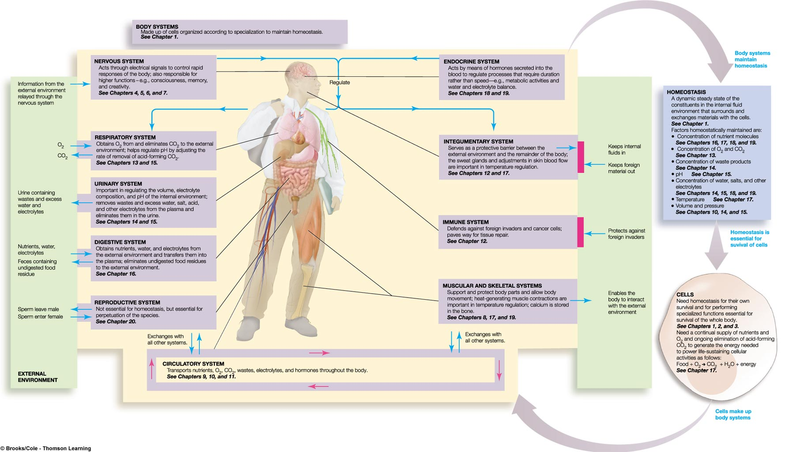
Role of Body Systems in Homeostasis

Slide 55
Disruptions in Homeostasis
Can lead to illness and death
Pathophysiology
Abnormal functioning of the body associated with disease

Slide 56
Disease
Any condition that prevents the body from working as it should
As a result the body may fail to maintain homeostasis
Disease may result from pathogens, abnormal cells, carcinogens, poor nutrition, inherited disorders or risky personal behavior

Slide 57
Causes of disease
Inherited disorders like Down Syndrome, Cystic Fibrosis, Sickle cell anemia
Exposure to toxins or carcinogens Lead poisoning, radiation poisoning
Poor nutrition Scurvy (Vit c deficiency), goiter (Iodine deficiency)
Organ dysfunction Heart attack ,Diabetes
High risk behaviors Lung cancer, drug addiction, skin cancer

Slide 58
References
Human physiology by Lauralee Sherwood, seventh edition
Text book physiology by Guyton &Hall,14th edition
Text book of physiology by Linda .s contanzo,third edition

